Slide 1

Monthly Income and Attrition
Philip Traxler

Slide 2
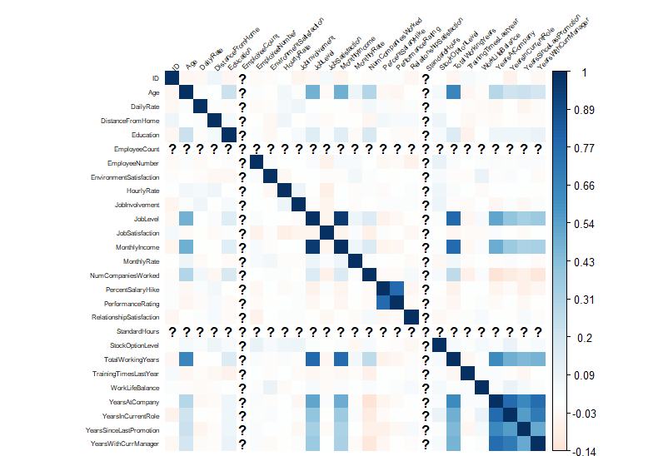
EDA Correlation Chart

Slide 3
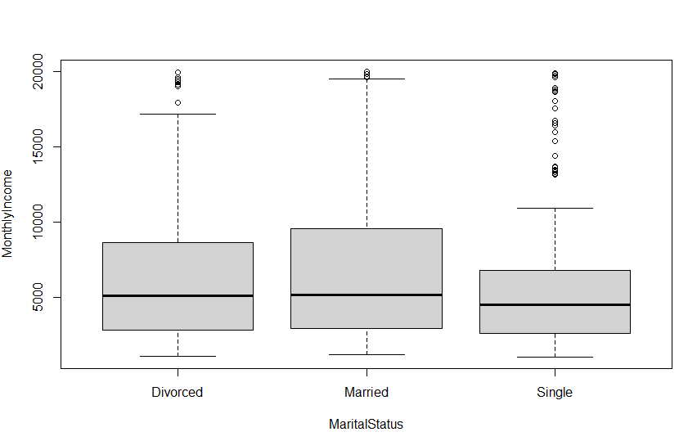
Narrowing it Down
Single employees are often paid the least.
Married employees have the widest range

Slide 4
Variables Used
Age
Department
Education
Job Level
Job Role
Number of Companies worked for
Total Working Years
Years at Company
Years in Current Role
Years Since Last Promotion
Years with Current Manager

Slide 5
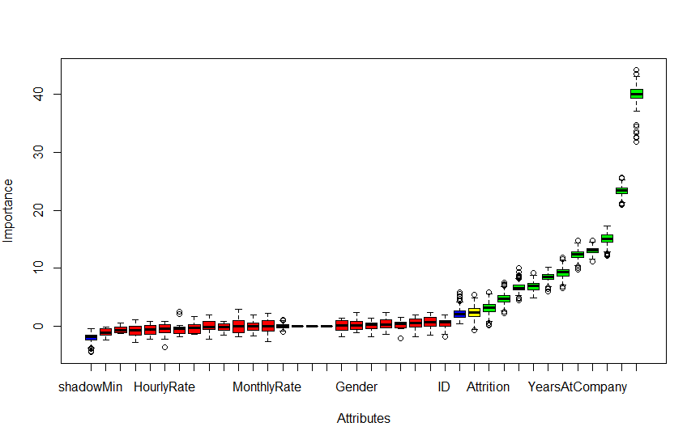
Variable Selection – Use of Boruta Analysis
Utilizing machine learning to test all features for the optimal model.

Slide 6
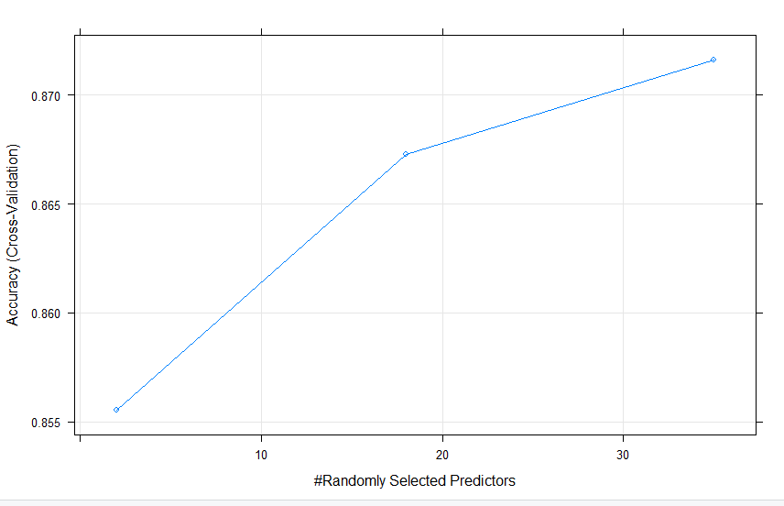
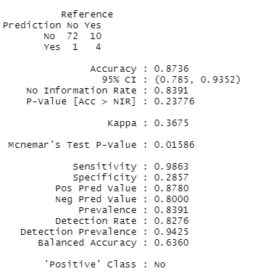
Naïve Bayes Model
The model below illustrates the accuracy and sensitivity of the model.
We are 87.36% confidence that the model will identify a difference in the Attrition given the variables used.

Slide 7
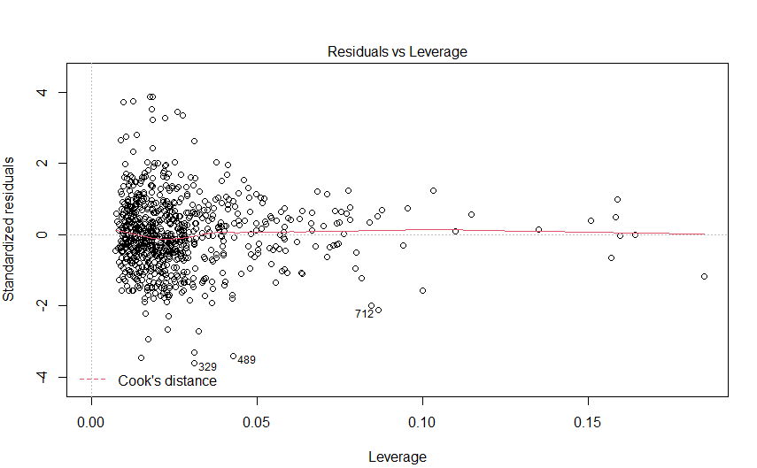
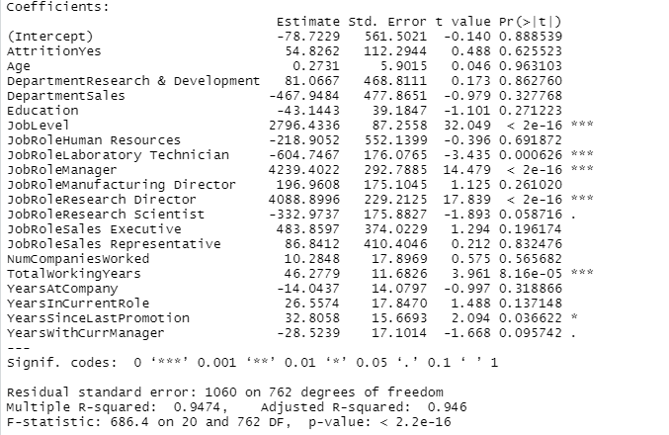
Linear Regression Model
The linear regression tells us that the model is highly predictive and that there are specific Job Roles that influence the model greater than other.
In addition to this, we find that 94% of the data is explained by the model.

